Slide 1
DEEP LEARNING
Abhay V R
ENG19CS0006

Slide 2
Deep Neural Networks
An artificial network consists of a pool of simple processing units which communicate by sending signals to each other over a large number of weighted connections. Many Neural networks together forms DNN.
It mainly has dense layers which consists of input, output and dense neurons.

Slide 3
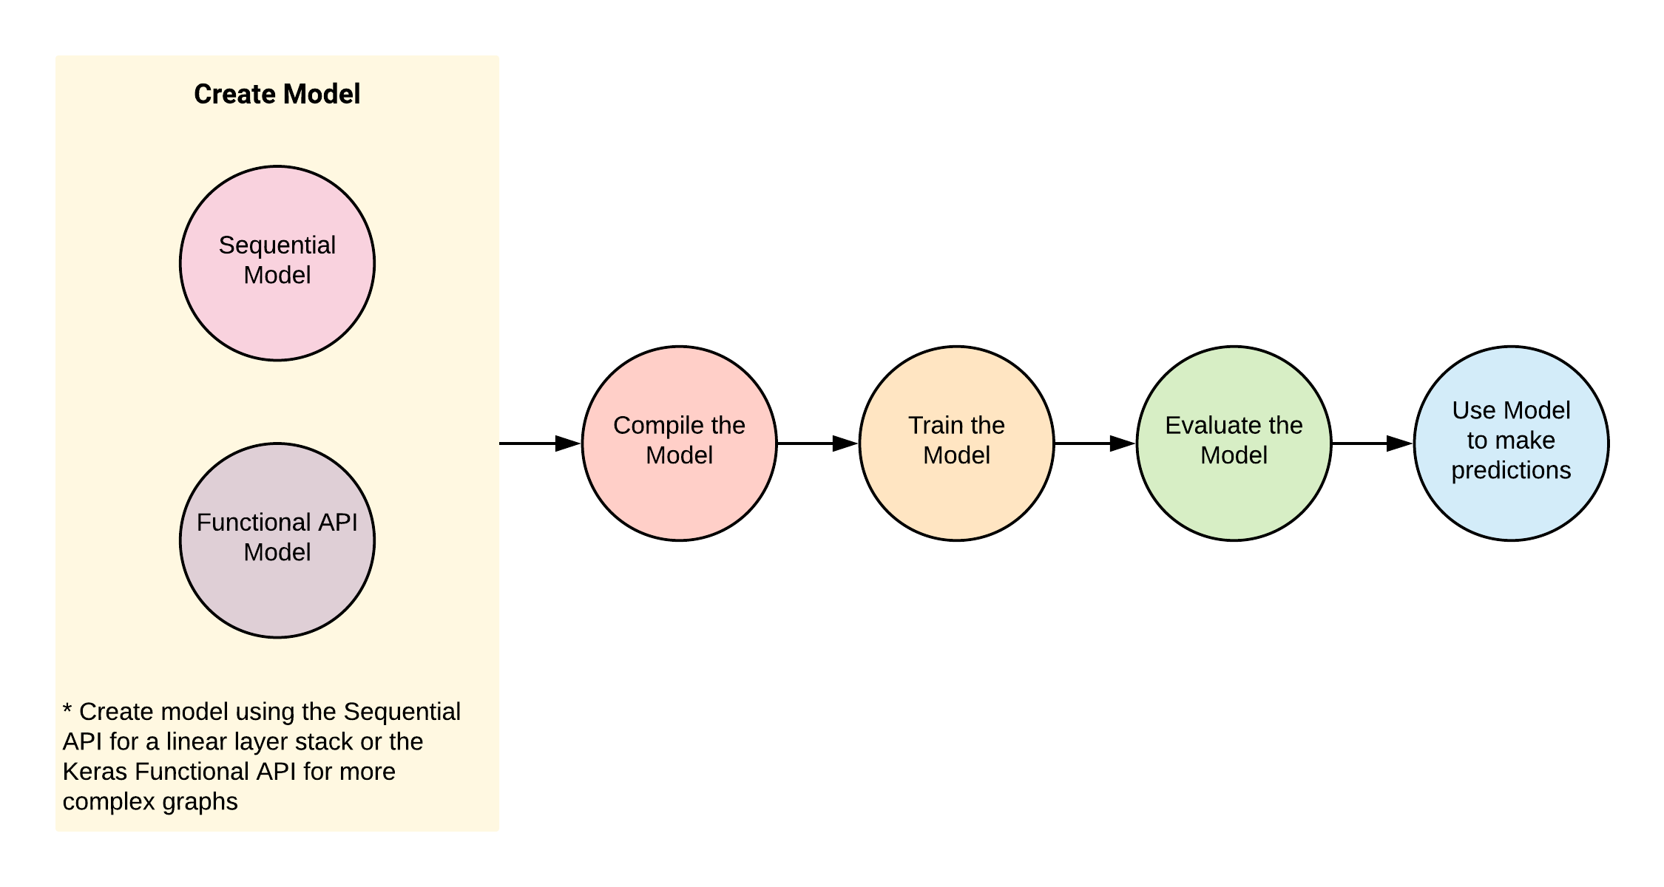
Deep Neural Networks

Slide 4
Forward feedback backward propagation loss function
Feed-forward neural networks take in a fixed amount of input data all at the same time and produce a fixed amount of output each time.It is used for more accuracy purpose.
Backward propagation - Is used to get more accuracy from DNN networks .
It is said to be done when one epoch is completed.
Loss function -Is a component of DNN(neural network), which is for the prediction of the error and to try to reduce the error as much as possible.
All these together makes DNN to be more accurate .

Slide 5
Transfer functions
Sigmoid – is used in DNN for classification purpose . It is used in the output layer. It is used in activation parameter.
Relu – is used in DNN for regression purpose. It is used in input as well as in output layer. It is used in activation parameter.
Tanh – is used very similar to the sigmoid function and is used for classification purpose.

Slide 6
Overfit underfit and optimal fit
Overfit – is when the errors are least in DNN but it is very complicated as all the points must be connected in the graph.
Underfit - is when the errors are most in DNN but it is very simple as all the points need not be connected in the graph.
Optimal fit – is when there are average errors in DNN but a mathematical equation can be produced by connecting few of the points.

Slide 7
Reference
Google colab - https://colab.research.google.com/drive/1SDszrBj4dEnjjnRIR6jzprOWNt7yLRdw
GitHub -https://github.com/ENG19CS0006-Abhay/Deep-learning-DNN-

Slide 8
Thank you

